Slide 1
Predicting health outcomes with NHANES questionnaire data
Peter Hong, Golvis Tavares, Mark Schramm
Fall 2023 - Machine Learning

Slide 2
Importance on the topic
Machine learning in healthcare
Predictive modeling for early detection - primary prevention
Possibility to personalized treatment that improves patient outcomes
Blood pressure: a silent precursor
High blood pressure can be an indicator of cardiovascular disease
Diabetes and its relation to Obesity
Escalating obesity pandemic in the country which exacerbating diabetes risk
Diabetes leads to various complications
Impact of COVID-19 on Healthcare conditions
Increased mental health issues, notably depression
Highlighted risks for individuals with chronic conditions
Notes:
Good evening everyone, today I’m here to talk about our project: Predicting health outcomes using NHANES questionnaire dataset

Slide 3
Dataset
CDC’s National Health and Nutrition Examination Survey (NHANES) conducted over 2 year periods
Using years 2013-14, 15-16, 17-18 (COVID-19 restrictions)
The surveys contain 43 questionnaires about a range of health topics
We chose a subset of 12 questionnaires that are related to our question of interst
Alcohol Use, Blood Pressure & Cholesterol, Cardiovascular Health, Current Health Status, Diabetes, Immunization, Income, Medical Conditions, Physical Activity, Mental Health - Depression Screener, Cigarette Use, Smoking - Second Hand Exposure
Notes:
It is important to note that the NHANES 2017-2020 data cycle encountered unique challenges due to the COVID-19 pandemic.
The pandemic led to the suspension of NHANES field operations in March 2020, meaning that the data collection for this cycle was incomplete and not nationally representative. The 2019-2020 dataset was yet to be available on the CDC’s website, and the latest combined version of 2017-2020 data was not comparable to previous years due to 1. A different 4-year sample design, 2 different primary sampling units (PSUs), and 3 strata.

Slide 4
Aim of this project
The dataset has many questions and we ended up picking 4 to predict: ['BPQ020', 'DIQ010', 'DPQ020', 'SMQ020']
These questions are:
Ever told you had high blood pressure (yes/no) by a health professional
Ever told have diabetes(yes/no) by a health professional
Feeling down, depressed, or hopeless over last 2 weeks (not at all/several days/> half, nearly every day)
Smoked at least 100 cigarettes in life(yes/no)
To predict these answers, we use data from other questionnaires
Notes:
When evaluating the outcome, other variables from the same survey is deleted from the model to avoid multicolinearity.

Slide 5
Data
(painful cleaning process - no joke）

Slide 6
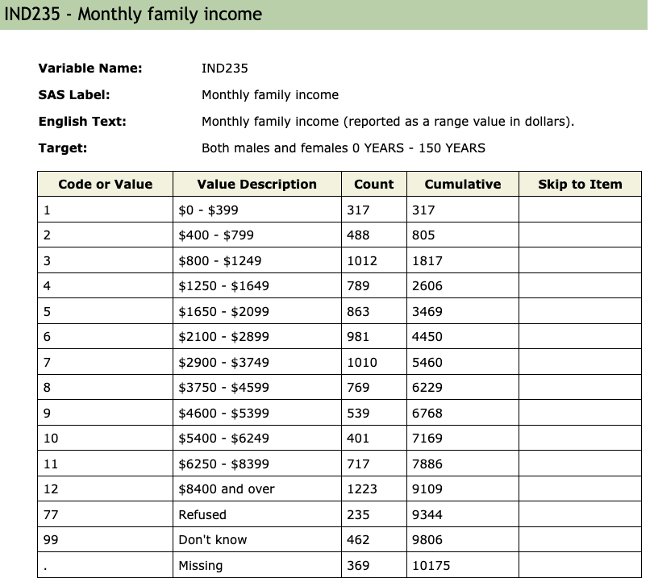
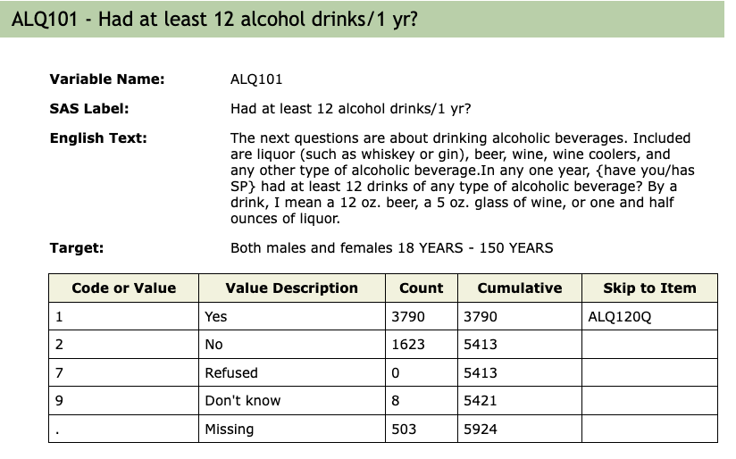
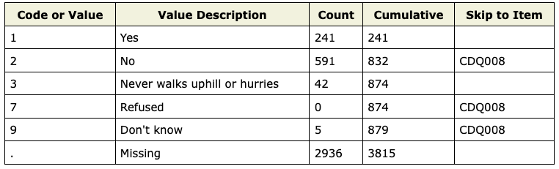
Notes:
Here's snapshot of what the data would look like, all the questionnaires are easily accessible on the CDC’s website, and all surveys are into subsections with XPT data (mainly used for SAS) available for download.

Slide 7
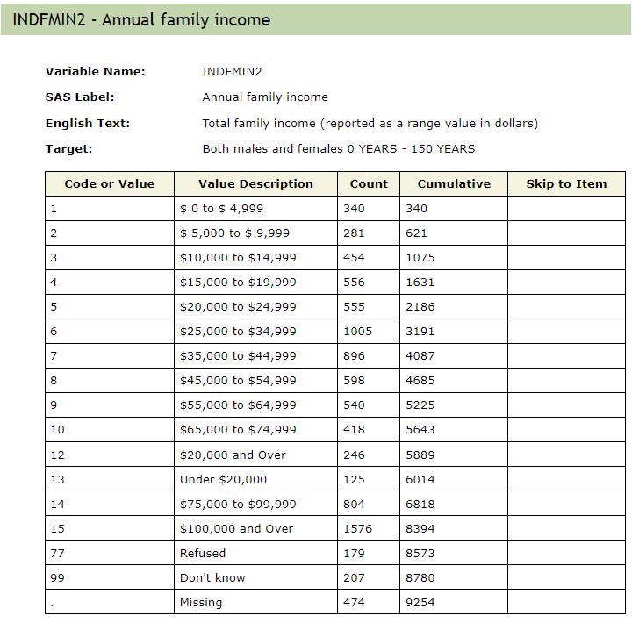
Notes:
Issues with the dataset as some of the categories overlaps making the variable unusable.
So use other variables such as ratio to poverty instead.

Slide 8
Challenges with Data
Questions between the different year’s surveys were slightly different
Special codes (7, 77…, 9,99…) mixed with numerical fields
Some categories are difficult to impute
E.g. age range 1-71 but having an option of greater than 50 yrs of age
Income (prev slide) categories have no ordinality
Lots of missing values
Notes:
There are some challenges with the data
Consistency issue. Because the survey was designed a while back and new questions are added, there are different number scheme used to represent the answer option of refused, and unknown. Some generic ones used 7 and 9 to represent these two respectively, but some have meaningful values for 7 and 9 so they used 77 and 99 for refused and unknown. While some newly added questions used 777, and 999, 7777, 77777 was also seen. So there was some manual labor put into practice to fish out the patterns
some answers were kind of random in terms of meaning, for example, in the previous slide, the question is “if the survey participant gets chest pain when walking when walking uphills or in a hurry” the answers are 1. Yes, 2. No, 3. Never walk uphill or in a hurry.

Slide 9
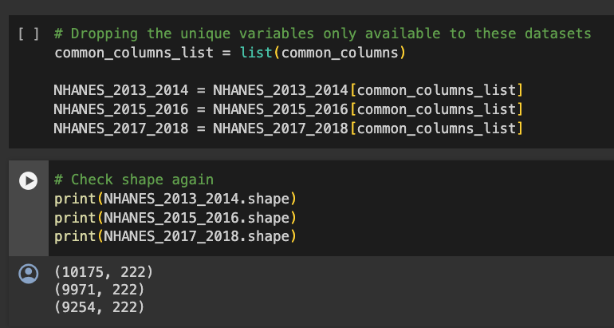
Standardizing Features between different years
Just kept the common columns between the years:
Our dataset before feature processing had:
~30k rows and 222 cols

Slide 10
Handling Missing Values
A major issue with the data-processing was handling lots of missing values
Strategies like average imputing would not make sense on a column that had majority of the values missing
We can afford to drop some columns
We dropped columns with > 50% of the values missing, after dropping the columns, we were left with 69 total features (appendix 1)
68 after dropping SEQN
Dropped rows that had missing target values
Notes:
Dropped variables that had more than 50% missing
Also dropped SEQN (patient identifier) as is was showing up on the feature importance chart due to its wide range

Slide 11
Handling Special Codes
To handle special codes, we tried some different strategies:
Imputing with a special number -999 - worked best for tree-based models
Adding indicator columns and average imputing was better for linear models

Slide 12
Scaling and Normalization
Most features were categorical
There were some scalar features like income so we tried StandardScaler
An overwhelming number of datapoints were (yes/no) and we did not go with StandardScaler
Notes:
After experiments we tried to normalize the age and condensing some of the variables to be only two categories

Slide 13
Training and Testing

Slide 14
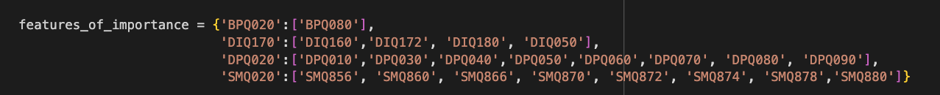
Splitting the Data
Given the time-dependent splits of our 3 surveys from 2015-18, we trained and validated models on the first 2 years and tested on the 3rd year
First used an 80/20 split to get a pipeline to test models up and running, then stratified k fold cross val
When testing on a particular variable, removed correlated features from the training features
Notes:
First model was built on year1 of the data with 80/20 split.
Then year2 was used to retrain the model also with 80/20 split.
Then year3 was used as testing data as a whole.

Slide 15
Training
Our targets were either binary targets or discrete scalar (mental health question)
LDA (Linear Discriminant Analysis)
GradientBoostingClassifier
XGBClassifier - Notably income was a huge predictor of blood pressure
SVM - (RBF SVM performed better than Linear SVM)
RandomForest
Logistic Regression
Lasso (to explore feature importance)
Notes:
We tested multiple models to see which one performs the best

Slide 16
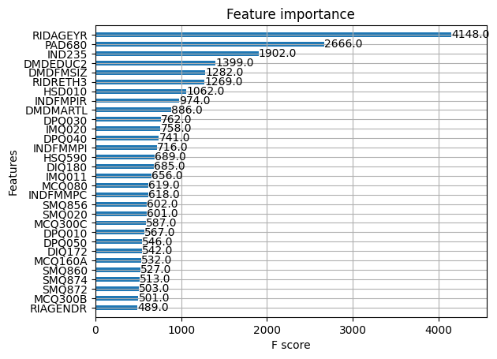
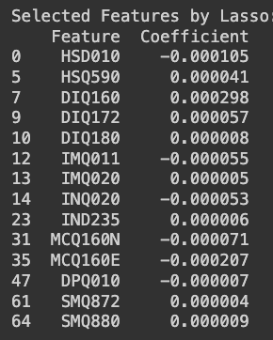
Feature Importance
Notes:
PAD680 - How much time {do you/does SP} usually spend sitting on a typical day?

Slide 17
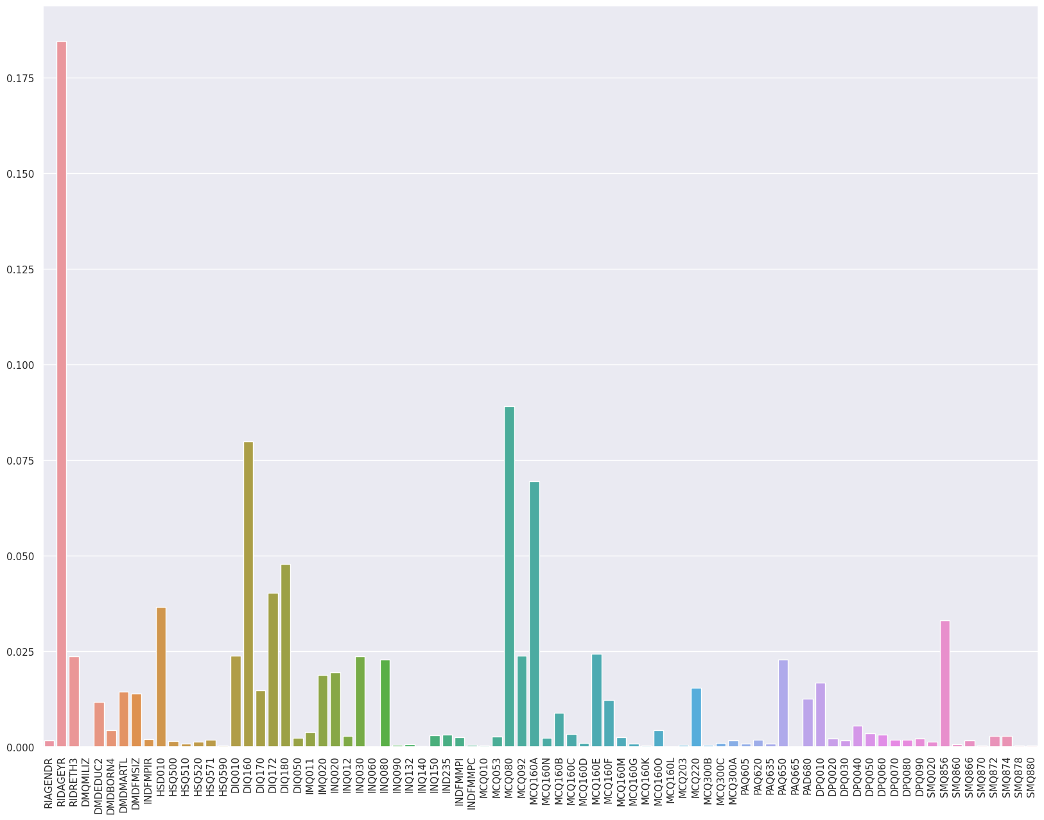
Notes:
Age
HSD160 - {Have you/Has SP} ever been told by a doctor or other health professional that {you have/SP has} any of the following: prediabetes, impaired fasting glucose, impaired glucose tolerance, borderline diabetes or that {your/her/his} blood sugar is higher than normal but not high enough to be called diabetes or sugar diabetes?
MCQ080 - Has a doctor or other health professional ever told {you/SP} that {you were/s/he/SP was} overweight?
MCQ160A - Has a doctor or other health professional ever told {you/SP} that {you/s/he} . . .had arthritis (ar-thry-tis)?
SMQ856 - During the last 7 days, {were you/was SP} working at a job or business outside of the home?
DIQ180 - {Have you/Has SP} had a blood test for high blood sugar or diabetes within the past three years?
DIQ172 - {Do you/Does SP} feel {you/he/she} could be at risk for diabetes or prediabetes?
This is the modeling result prior to normalizing the age, as you can see that it is extremely high for age

Slide 18
Results for BPQ020
 | Precision | Recall | F1-Score | Accuracy | MSE
GradientBoostingClassifier | .71 | .63 | .67 | .79 | .21
XGBoostClassifier | .73 | .72 | .08 | .76 | 1.18
SVM(rbf) | .65 | .27 | .38 | .71 | .29
RandomForestClassifier | .61 | .60 | .61 | .74 | .26
LDA | .66 | .58 | .62 | .76 | -0.09
LogisticRegression | .70 | .57 | .62 | .77 | .23
Notes:
Here’s the results for all different models. Overall Gradient boosting performed the best.
This may because Gradient boosting is better at capturing the complex relationship that health data often has.

Slide 19
Best Model - GradientBoostingClassifier
Best parameters: {'learning_rate': 0.1, 'max_depth': 2, 'max_features': 'log2', 'min_samples_leaf': 1, 'min_samples_split': 6, 'n_estimators': 200, 'random_state': 42, 'subsample': 0.2}
Best estimator: GradientBoostingClassifier(max_depth=2, max_features='log2',min_samples_split=6, n_estimators=200, random_state=42, subsample=0.2)
GridSearchCV params (appendix 2)
Tree plot (appendix 3)

Slide 20
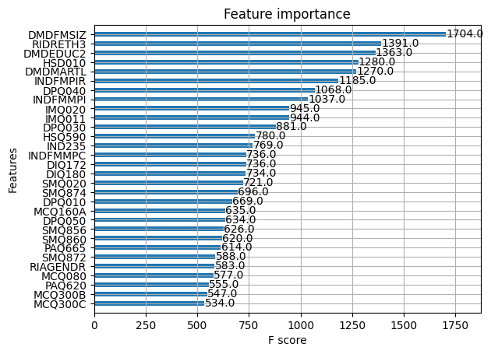
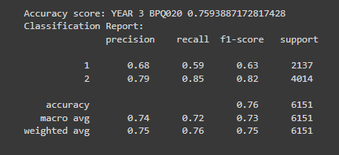
Hypertension
Notes:
Hypertension

Slide 21
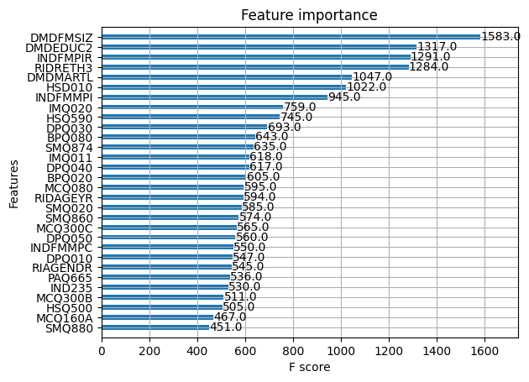
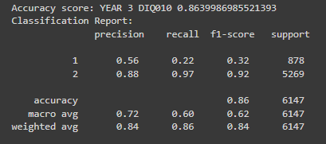
Diabetes
Notes:
Diabetes doesn’t have a great outcome, despite having a high accuracy. But because more than 90% participants have negative outcome, it is not really meaningful result.
We have training and testing data stratified based on the outcome.

Slide 22
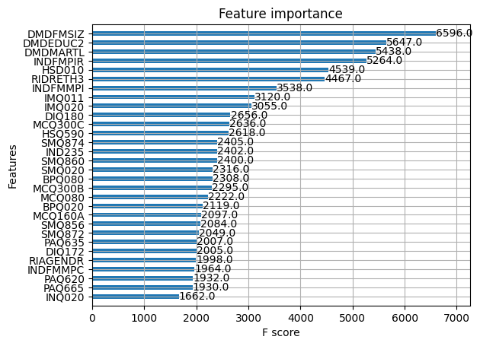
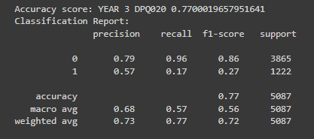
Depression

Slide 23
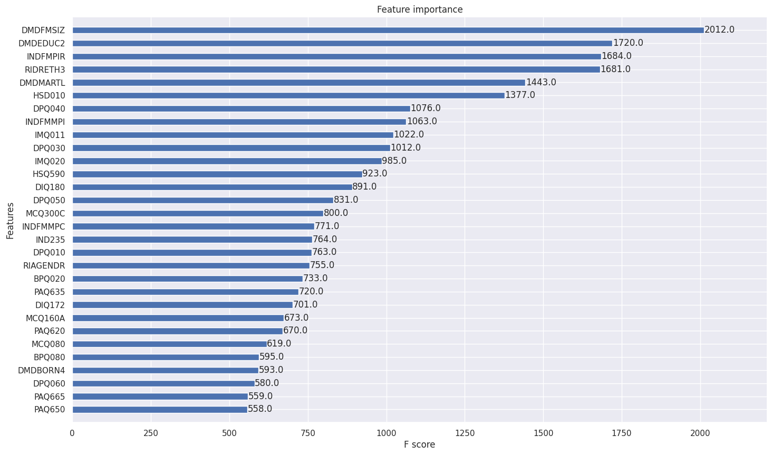
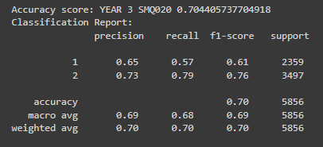
Smoking 100 cigarettes

Slide 24
Implication and applications
Upsampling of outcome population and more balanced target
If we can make accurate predictions, then fewer surveys can be conducted lowering expense
Model can be used to infer missing values in the dataset and allow for self-supervised learning and an improved overall dataset

Slide 25
Links
Data: https://wwwn.cdc.gov/nchs/nhanes/default.aspx
IPYNB(private): https://colab.research.google.com/drive/15LI9pK9nv9U_U6sfxr_wlDjF1JUJdGxY#scrollTo=bwWiOkhnY_sG
Appendix (private): https://docs.google.com/document/d/1_lPQ5Rf1k0dD9iPg4ch8LvcLKKe7JPhy1cfA1VMjcSk/edit
GH: https://github.com/mdschramm/nhanes-proj

Slide 26
Thank you

